Slide 1
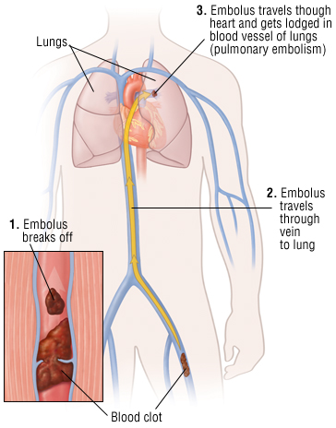
High prevalence of venous thromboembolic disease among HIV patients co-infected with drug-resistant TB in Lesotho
David Holtzman¹, Meseret Asfaw¹, Llang Maama², Patrick Nkundanyirazo¹, Lawrence Oyewusi¹
1 - Partners In Health – Lesotho, 2 - Lesotho Ministry of Health, dholtzman@pih.org
Background
Venous thromboembolic (VTE) disease is a serious medical condition caused by abnormal blood clotting in veins (Figure 2).
HIV, tuberculosis (TB), and other acute and chronic infections causing systemic inflammation are associated with an increased risk of VTE disease.
VTE rates of 0.6-3.4% have been previously described in TB cohorts. No studies have described VTE in drug-resistant TB (DR TB) specifically.
Our study explored occurrence of VTE among a cohort of DR TB patients in Lesotho where HIV co-infection is very high (25% prevalence in 15-49 year olds).
Blood clots occur commonly among people with drug-resistant tuberculosis and HIV (8%)
Blood clots usually occur in first 3 months of TB treatment and in hospitalized patients.
TB and HIV programs and clinicians should implement measures to prevent, identify & treat blood clots among high-risk patients.
Methods
Retrospective cohort study with primary outcome of clinically or radiographically confirmed VTE disease.
Cohort consisted of consented individuals with DR TB initiated on bedaquiline or delamanid enrolling in prospective observational endTB study site in Lesotho between October 2015 – June 2018.
endTB study database queried for VTE adverse events.
Hospital and pharmacy records also searched for prescription of anti-coagulant/anti-thrombotic medications.
Manual chart review subsequently conducted for all potential VTE cases in order to confirm diagnosis of VTE.
Relevant demographic and clinical data abstracted and univariate analysis conducted.
VTE Pathogenesis
Virchow’s triad (Figure 1) is a theory to describe the risk factors and mechanism for VTE disease. It states that VTE is more likely to occur when there is slowed blood flow, damage to blood vessels’ lining, and an increased tendency of the blood to clot.
Suspected mechanisms of VTE in HIV and TB include increased clotting as a result of inflammation, damage to blood vessels from the infection and/or inflammation, and decreased blood flow due to decreased patient mobility from their illness.
211 patients enrolled
33 potential VTE episodes identified
Results
8% of the cohort experienced episode of VTE (all episodes were deep vein thrombosis – DVT). PE difficult to diagnose due to limited CT scanning availability.
Female gender weakly associated with VTE.
Most participants were HIV-positive with low CD4 and high viral load regardless of VTE.
No traditional VTE risk factors were found to be significantly associated with VTE.
Most VTE episodes occurred in the first 3 months of TB treatment (average 69 days) and most hospitalized prior to developing VTE.
No observed differences in TB treatment outcomes between those with & without VTE but treatment success was good (69% overall) as well as mortality (23%).
Confirmed VTE - 17
No VTE - 194
Figure 3: Flow diagram of cohort & VTE episodes
Variable | VTE | No VTE |  | p-value
N (%) | 17 (8%) | 194 (92%) |  | --
Age (years) | 41 | 43 |  | 0.87
Female | 10 (59%) | 67 (35%) |  | 0.06
HIV positive | 16 (94%) | 154 (79%) |  | 0.21
Baseline CD4 (cells/mm³) | 187 | 202 |  | 0.78
Baseline VL (copies/ml) | 419,718 | 328,424 |  | 0.76
Hospitalized before VTE | 12 (71%) | -- |  | --
Median days from start of TB Rx to VTE diagnosis | 69 | -- |  | --
TB treatment outcome | N = 209 with final outcome
Cured/completed | 11 (65%) | 133 (69%) | 0.73
Died | 4 (24%) | 45 (23%) | 0.93
Failed | 0 | 2 (1%) | 0.68
Loss to follow-up | 0 | 2 (1%) | 0.68
Not evaluated | 2 (12%) | 10 (5%) | 0.23
Table 1: Comparison of clinical and demographic characteristics between participants with and without VTE
tendency of blood to clot
risk of VTE
Conclusions
VTE disease is common in DR TB/HIV co-infected patients. Early VTE onset suggests possible initial state of increased propensity towards thrombosis formation.
Further study is needed to better understand risk factors for VTE in this population in order to target and implement measures to mitigate.
damage to blood vessel lining
blood flow within veins
Figure 2: Most common forms of VTE: deep vein thrombosis (DVT) and pulmonary embolism (PE) www.health.harvard.edu
Figure 1: Virchow’s triad theory for venous thrombosis
PRESENTED AT THE 23RD INTERNATIONAL AIDS CONFERENCE (AIDS 2020) | 6-10 JULY 2020

